Slide 1


DATA SCIENCE BOOK
AMAZON.COM
Presented By:
1. P.Pranav karuppiah-Solamalai College of Engineering-Civil Engineering

Slide 2
OUTLINE
○
Probelm Statement
Proposed Solution
System Approach
Algorithm & Deployment
Result
Conclusion
Future Scope
References
○ ○ ○ ○
○
○ ○

Slide 3
PROBLEM STATEMENT
This dataset comes from research by Civil Engineering department.
The aim of the study is to determine Overall, "Data Science for Business" provides a practical and accessible introduction to data science concepts and techniques, with a focus on their real-world applications in business settings. It is suitable for both technical and non-technical readers who are interested in leveraging data for business success.

Slide 4
PROPOSED SOLUTION
Setting Parameters:
Introduction to Data Science
Predictive Modeling
Ethical and Legal Considerations
Evaluation and Validation

Slide 5
SYSTEM APPROACH
Building the proposed solution would involve a combination of data processing,feature engineering,and machine learning. Here are the key system and library requriements.
System Requirements:
1.Hardaware:
A computer with sufficent processing power,perferably wwith multiple cores or a GPU for faster traning of machine learning models.
Adequate RAm to handke the size of the saraset and computational requriments.
2. Software:
An operating syatem compatible with the requrired machine learning libraries(eg., Windowa=s, linux,macsOS).

Slide 6
ALGORITHM & DEPLOYMENT
Python
The definition of a program at its most basic is a sequence of Python statements that have been crafted to do something. Even our simple hello.py script is a program. It is a one-line program and is not particularly useful, but in the strictest definition, it is a Python program.
Steps to implement thep python
Download Thonny IDE.
Run the installer to install Thonny on your computer.
Go to: File > New. Then save the file with .py extension. For example, hello.py, example.py, etc. You can give any name to the file. However, the file name should end with .py
Write Python code in the file and save it.

Slide 7
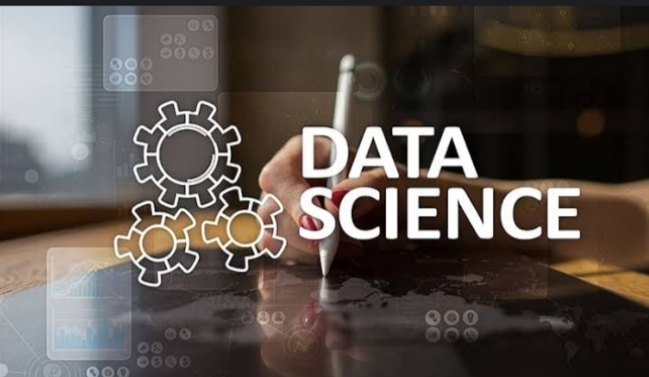
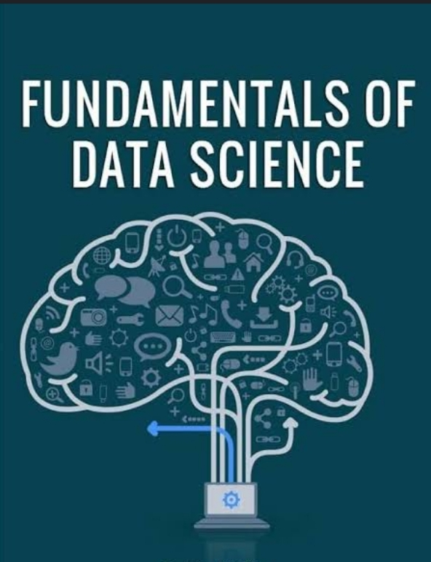
RESULT

Slide 8
CONCLUSION
To express and aware of data and fundamental science related problems

Slide 9
FUTURE SCOPE
The future went ot Artificial Intelligence so data science books will be subjected for primary and secondary 8for students.

Slide 10
REFERENCES
https://www.kaggle.com/datasets/afumetto/3dprinter

Slide 11
THANK YOU

Slide 12
ALGORITHM & DEPLOYMENT
K-Nearest Neighbors (KNN) algorithm
The K-Nearest Neighbors (KNN) algorithm is a popular machine learning technique used for classification and regression tasks. It relies on the idea that similar data points tend to have similar labels or values. During the training phase, the KNN algorithm stores the entire training dataset as a reference.
Steps to implement the K-NN algorithm:
Data Pre-processing step
Fitting the K-NN algorithm to the Training set
Predicting the test result
Test accuracy of the result(Creation of Confusion matrix)
Visualizing the test set result.

